Slide 1



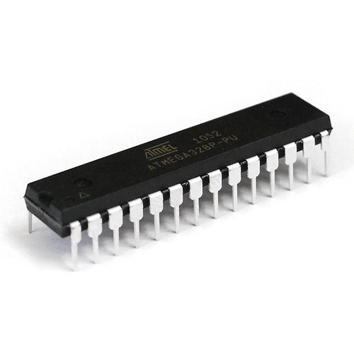
Robotics INC
INTRODUCTION TO
MICROCONTROLLER
& ARDUINO
Presented By
Yubraj Khatri

Slide 2
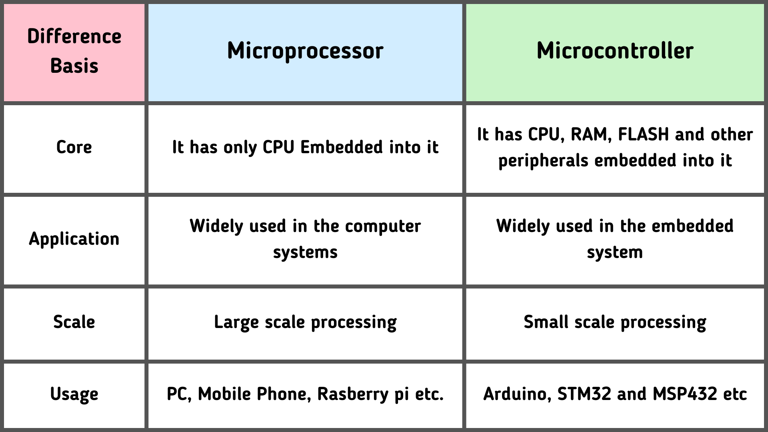

Slide 3

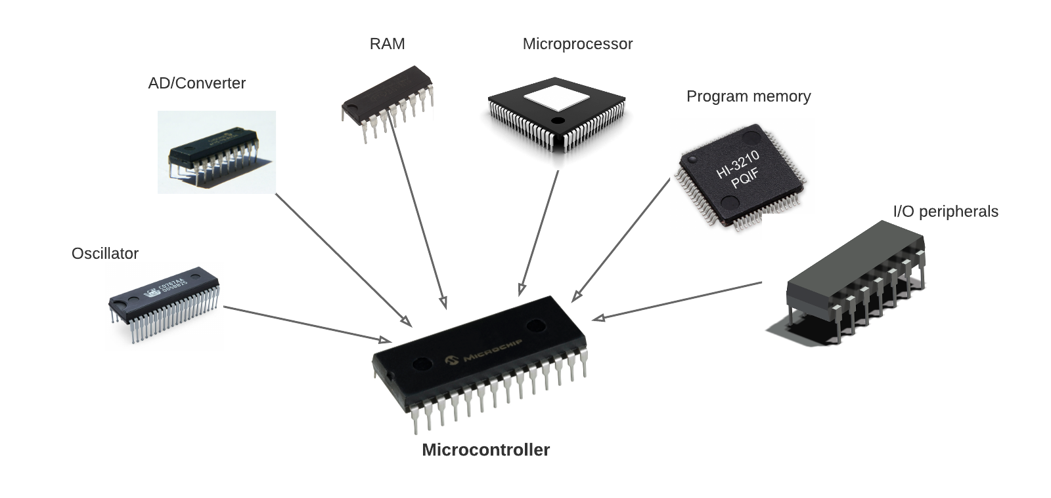
MICROCONTROLLER
It is specially designed circuits for embedded applications and is widely used in automatically controlled electronic devices. It contains memory, processor, and programmable I/O.
It’s types:
○ Intel MCS-51
○ 8051 microcontroller
○ AVR microcontroller
○ PIC microcontroller

Slide 4
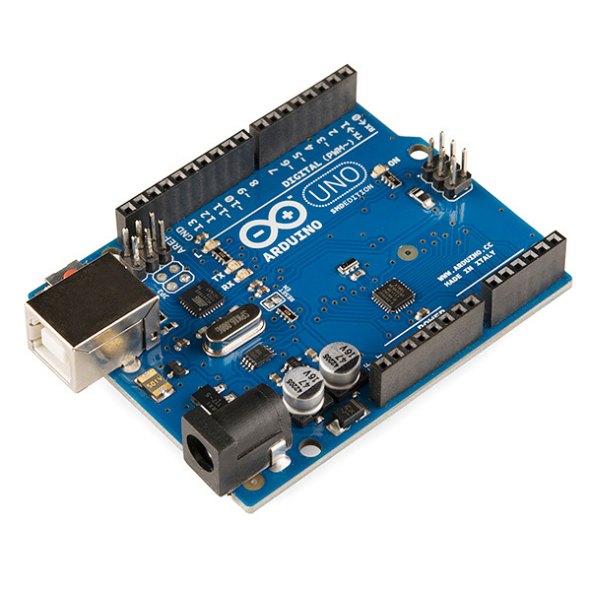

ARDUINO
The Arduino board is a small microcontroller board, which is a small circuit that contains a whole computer on a small chip (the microcontroller).
Arduino is composed of two major parts:
○ Arduino board
○ the IDE
IDE uses simplifier version of C and C++ programming language.

Slide 5

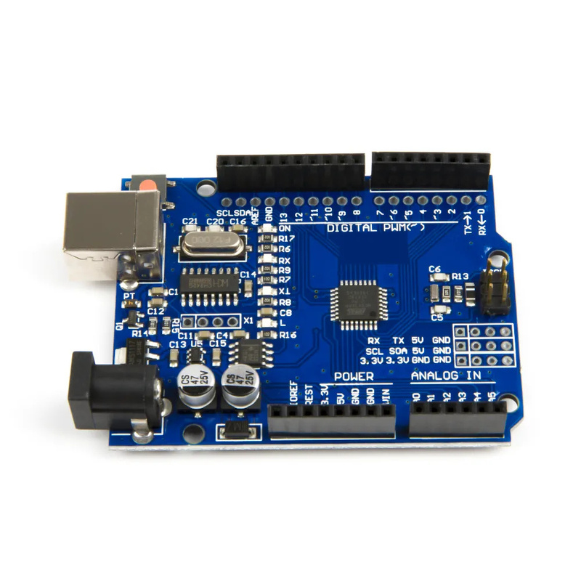
SPECIFICATIONS
Microcontroller: ATmega 328P
Operating Voltage: 5V
Input Voltage: 7-12 V
Digital I/O Pins: 14 pins (including 6 PWM Pins)
Analog input Pins: 6
DC Current / pin : 40mA
DC Current whole Pins: 200mA
Flash memory: 32 KB
SRAM: 2KB
EEPROM: 1 KB
Clock Speed: 16 MHz

Slide 6

MAJOR
COMPONENTS
USB Connector
Power Port
Microcontroller (ATmega 328P)
Analog Input Pins (A0-A5)
Digital Input Pins (0-13)
Reset Switch
Crystal Oscillator (16 MHz)
USB Chip Interface
RX TX LED’s

Slide 7
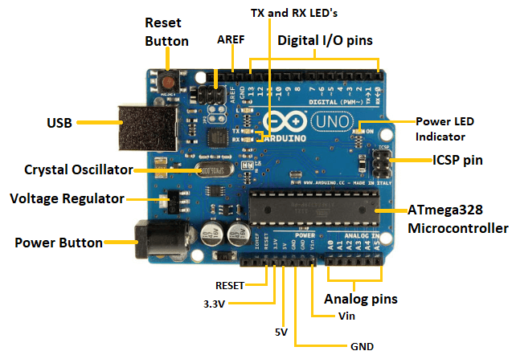

Slide 8
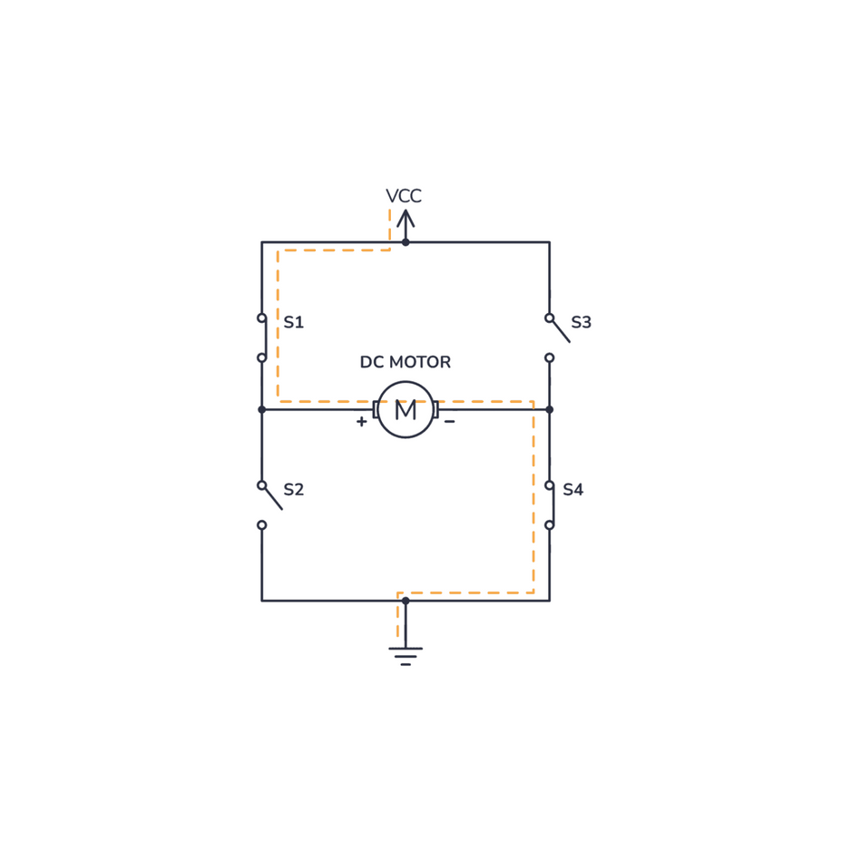
H-BRIDGE
APPLICATIONS
The most important application of the H-Bridge circuit as the motor driver circuit.
In Robotics Technology, H-bridge circuits are used.

Slide 9
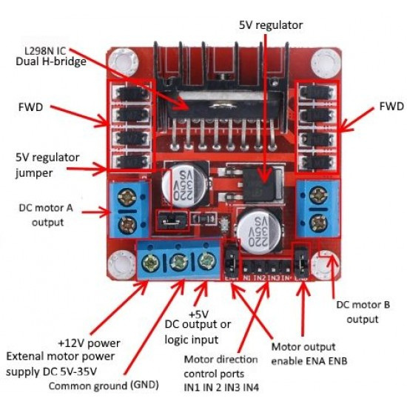
MOTOR DRIVER (L298N)

Slide 10
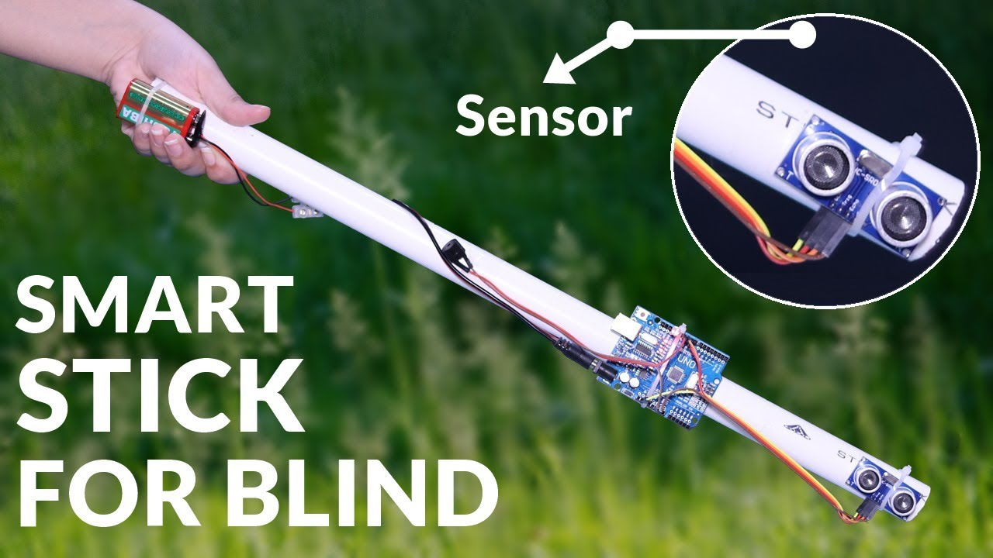
BLIND MAN STICK

Slide 11

BLIND MAN STICK

Slide 12
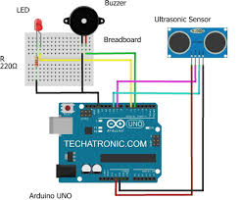
COMPONENTS

Slide 13
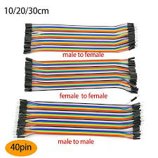
COMPONENTS

Slide 14


Thynk Unlimited
Robotics INC
THANK
YOU

